Slide 1
BRITISH AIRWAYS AIRLINE REVIEW
SKYTRAX REVIEWS ON BRITISH AIRWAYS AIRLINE
FORTUNE NWANKWO (THE WEIRD ANALYST)

Slide 2
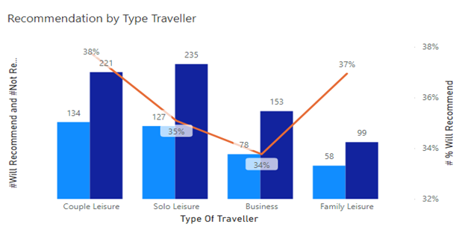
RESULTS
Key Travellers
Customers who travel for leisure purposes responded positively in reviews. This shows that BA Airlines is doing quite enough to attract tourists.
Reviews
Out of 1105 reviews, only 397 customers (36%) responded positively to recommending British Airways Airlines.
British Airways Airlines also received an average 4.4/10 rating.
This shows that many people are not satisfied with the Airlines.
4.4/10
Average Rating
36%
Recommendation likelihood

